Slide 1
FINANCE MANAGEMENT SYSTEM
VELMURUGAN S
2021503317

Slide 2
OVERVIEW:
Financial Reporting:
Financial Statements: Generates standard financial statements such as income statements, balance sheets, and cash flow statements.
Custom Reporting: Allows for the creation of customized reports to meet specific business needs.
Real-time Reporting: Provides up-to-date financial information for quick decision-making.
Accounting:
General Ledger: Tracks all financial transactions and maintains a record of accounts.
Accounts Payable: Manages outgoing payments and vendor invoices.
Accounts Receivable: Handles incoming payments and customer invoices.
Cash Management: Monitors cash flow, ensuring there is enough liquidity to meet financial obligations.

Slide 3
Compliance and Risk Management:
Compliance Monitoring: Ensures that financial operations adhere to regulatory requirements and industry standards.
Risk Assessment: Identifies and manages financial risks associated with the business.
Security and Audit Trails:
User Permissions: Defines roles and permissions to restrict access to sensitive financial data.
Audit Trails: Maintains a detailed log of all financial transactions and user activities for auditing purposes.

Slide 4
PROBLEM STATEMENT:
The reliance on manual data entry and paper-based systems results in a high probability of errors in financial transactions and reporting.
Inefficiencies in data reconciliation and validation processes lead to delays and inaccuracies in financial statements.
The current financial management system lacks robust reporting tools, making it difficult for stakeholders to access real-time financial information.
Manual compliance tracking processes are prone to oversights, exposing the organization to regulatory risks and potential legal consequences.
The current system lacks robust security features, posing a potential risk to the confidentiality and integrity of sensitive financial data.
Inadequate user access controls may lead to unauthorized access and potential data breaches.

Slide 5
OBJECTIVE:
Maximizing profits: Provide insights on, for example, rising costs of raw materials that might trigger an increase in the cost of goods sold.
Tracking liquidity and cash flow: Ensure the company has enough money on hand to meet its obligations.
Ensuring compliance: Keep up with state, federal and industry-specific regulations.
Developing financial scenarios: These are based on the business’ current state and forecasts that assume a wide range of outcomes based on possible market conditions.
Manage relationships: Dealing effectively with investors and the boards of directors.

Slide 6
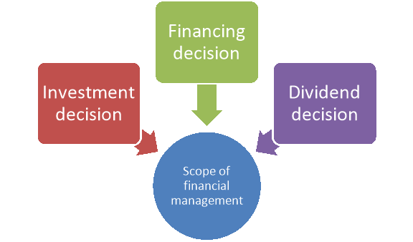
SCOPE:
1.Planning:
The financial manager projects how much money the company will need in order to maintain positive cash flow, allocate funds to grow or add new products or services and cope with unexpected events, and shares that information with business colleagues.

Slide 7
2.Budgeting:
The financial manager allocates the company’s available funds to meet costs, such as mortgages or rents, salaries, raw materials, employee T&E and other obligations. Ideally there will be some left to put aside for emergencies and to fund new business opportunities.
3.Managing and assessing risk:
Line-of-business executives look to their financial managers to assess and provide compensating controls for a variety of risks, including:
Market risk: Affects the business’ investments as well as, for public companies, reporting and stock performance.
Credit risk: The effects of, for example, customers not paying their invoices on time and thus the business not having funds to meet obligations, which may adversely affect creditworthiness and valuation, which dictates ability to borrow at favorable rates.

Slide 8
IMPORTANCE OF FMS:
1.Strategizing
Identifying what needs to happen financially for the company to achieve its short- and long-term goals. Leaders need insights into current performance for scenario planning, for example.
2.Decision-making
Helping business leaders decide the best way to execute on plans by providing up-to-date financial reports and data on relevant KPIs.
3.Controlling
Ensuring each department is contributing to the vision and operating within budget and in alignment with strategy.

Slide 9
FUNCTIONAL REQUIREMENTS:
1. User Management:
Registration: Describe the process for users to register.
Authentication: Specify how users will be authenticated.
Authorization: Define different user roles and their access levels.
2. Account Management:
Account Creation: Describe how users can create financial accounts.
Account Types: Specify the types of accounts supported (e.g., savings, checking).
Account Transactions: Define the types of transactions allowed (e.g., deposits, withdrawals).

Slide 10
3. Transaction Management:
Recording Transactions: Specify how users can record financial transactions.
Transaction Categories: Define different categories for transactions (e.g., income, expenses).
Transaction History: Describe how users can view their transaction history.
4. Budget Management:
Budget Creation: Specify how users can create budgets.
Budget Categories: Define different categories for budgets (e.g., food, transportation).
Budget Tracking: Describe how users can track their budget versus actual spending.
5. Reporting:
Financial Reports: Specify the types of financial reports available (e.g., balance sheet, income statement).
Custom Reports: Describe if users can create custom reports.

Slide 11
NON FUNCTIONAL REQUIREMENTS:
1. Performance:
Response Time: Specify acceptable response times for different actions.
Concurrent Users: Define the system's capacity to handle concurrent users.
2. Reliability:
System Availability: Specify the required uptime percentage.
Data Integrity: Define measures to ensure data integrity.
3. Security:
Data Encryption: Specify how sensitive data will be encrypted.
Access Control: Describe measures to control user access.
4. Usability:
User Interface: Specify design principles and guidelines.
Training: Describe any training requirements for users.

Slide 12
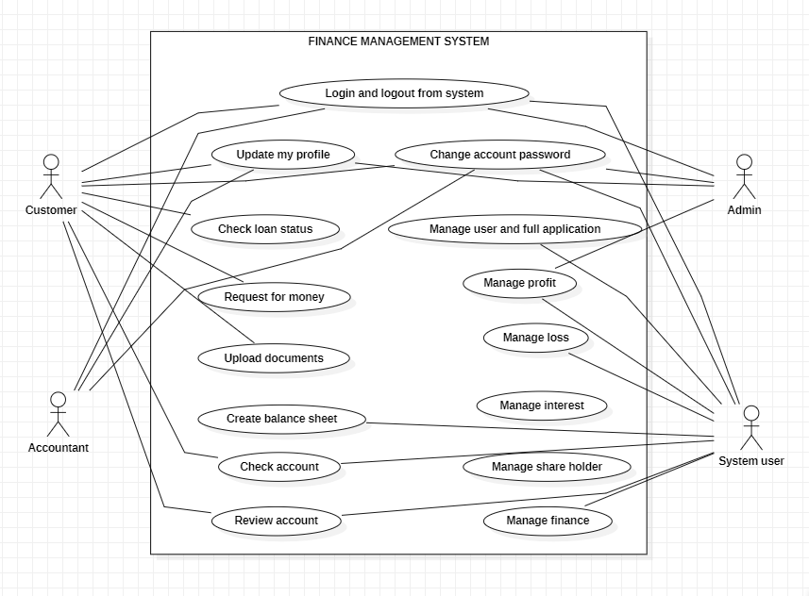
USE CASE DIAGRAM:

Slide 13
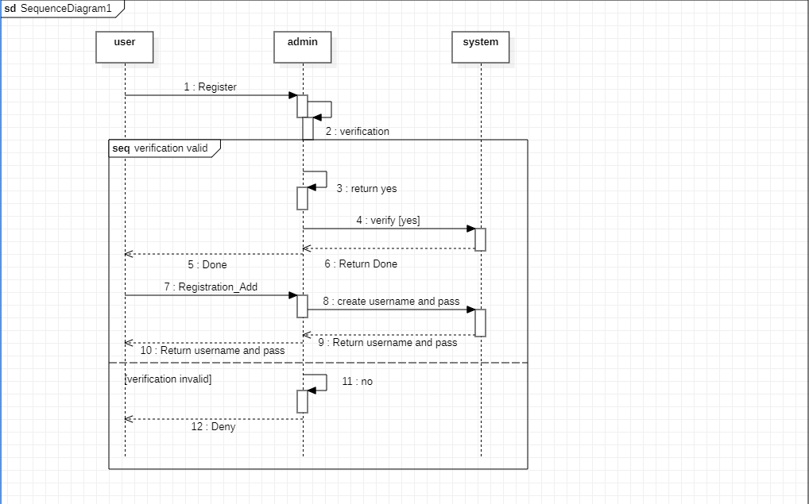
SEQUENCE DIAGRAM: 1.Sequence diagram for opening an account:

Slide 14
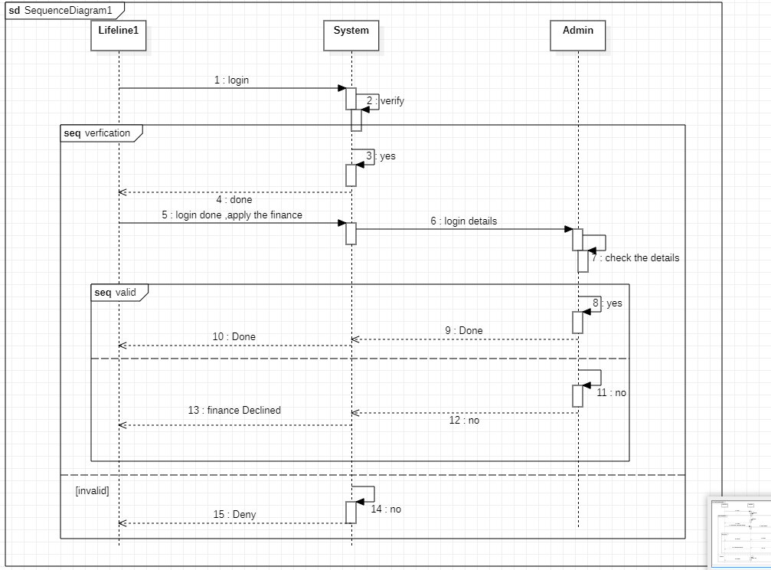
2.Sequence diagram for applying loan:

Slide 15
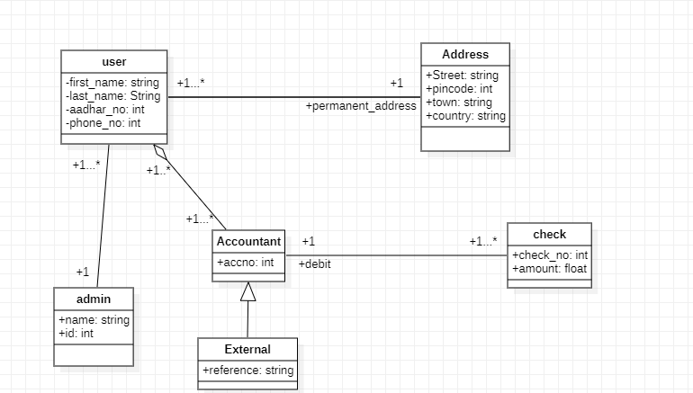
CLASS DIAGRAM:

Slide 16
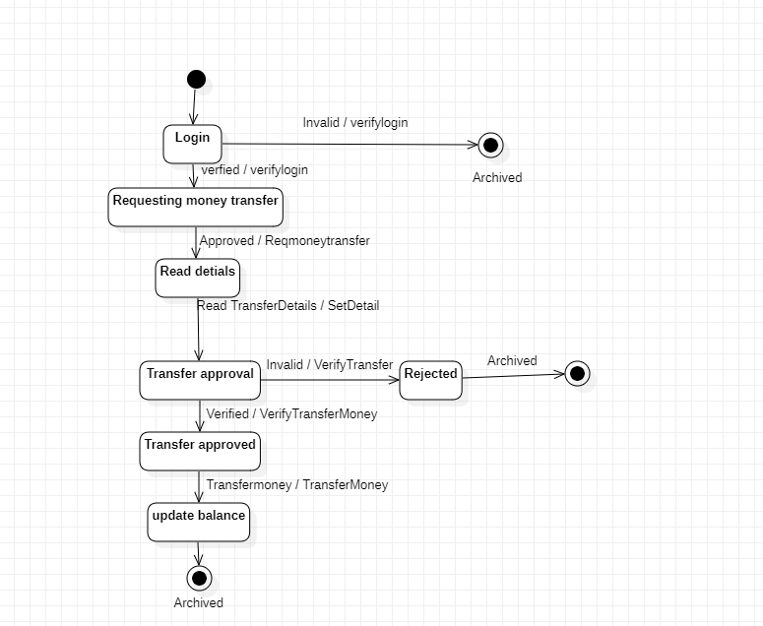
STATE CHART DIAGRAM:

Slide 17
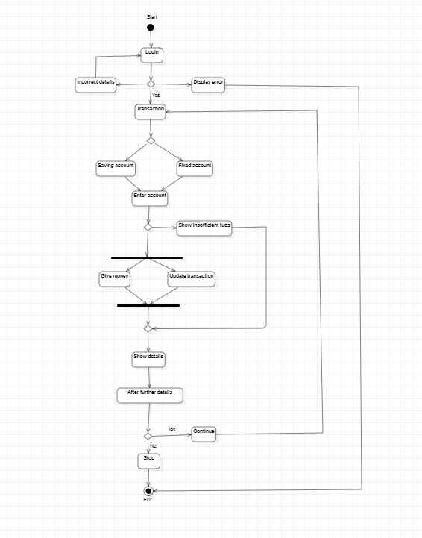
ACTIVITY DIAGRAM:

